Slide 1
2025-2026 LCAP annual Update
2024-2027 Local Control and Accountability Plan
LCAP and State & Federal| LCAP Engagement | June 10, 2025
Notes:
Good Evening President Stevens, Vice-President Colon, Clerk Donaire, Board of Trustees, Superintendent Dr. Rodriguez, Staff and Community.
Thank you for the opportunity to present the district’s 2025-2026 LCAP Annual Update on the 2024-2027 Local Control Accountability Plan (LCAP) for the Public Hearing.
This public hearing provides the public opportunities for formal comments and inquiries on the LCAP and responses prior to the adoption.

Slide 2
LCAP OVERVIEW
Notes:
I would like to provide a quick overview of the LCAP.

Slide 3
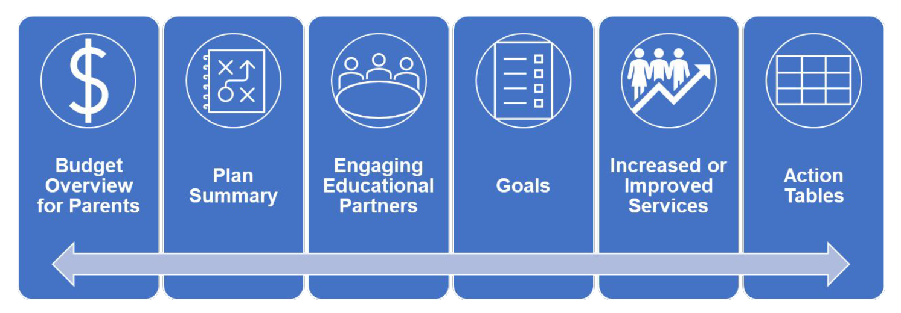
WHAT IS THE LCAP?
Highlights
3-year plan
Updated Every Year
Includes
Goals
Actions
Estimated Costs
Data on what worked or not
District Level
Posted on the website: www.stocktonusd.net/lcap
Notes:
The LCAP is a 3-year district plan that provides details on goals to achieve, actions to implement, estimated costs to expend, and data to support effectiveness.
The LCAP is comprised of six (6) sections, these are: Budget Overview for Parents, Plan Summary, Educational Partners, Goals and Actions.
As a reminder the LCAP is available on the district’s Local Control & Accountability (LCAP) website: www.stocktonusd.net/lcap.

Slide 4
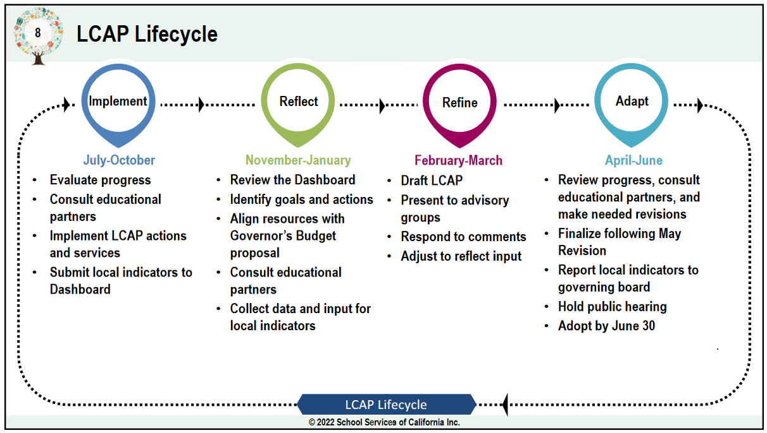
Lcap LIFECYCLE – where are we at?
What’s Ahead
June 10 – Public Hearing
June 24 – LCAP Adoption
June 25 – LCAP Submission to SJCOE
August 15 – SJCOE Completes Review of LCAP
September 2025 – SJCOE Approval of LCAP
Notes:
In terms of the timeline or lifecycle of an LCAO, we are currently at the last stage according to the image, with today being the Public Hearing. Our next milestone is June 24, when the board is presented the final LCAP for adoption. The final approval will occur in September 2025 when SJCOE formally approves the LCAP.

Slide 5
LCAP sections and elements

Slide 6
LCAP Sections
Pages 1-3
Pages 4-14
Pages 15-24
Pages 25-176
Pages 177-214
Pages 215-237
Notes:
As mentioned before, the LCAP has 6 specific sections. I will briefly go over each one.

Slide 7
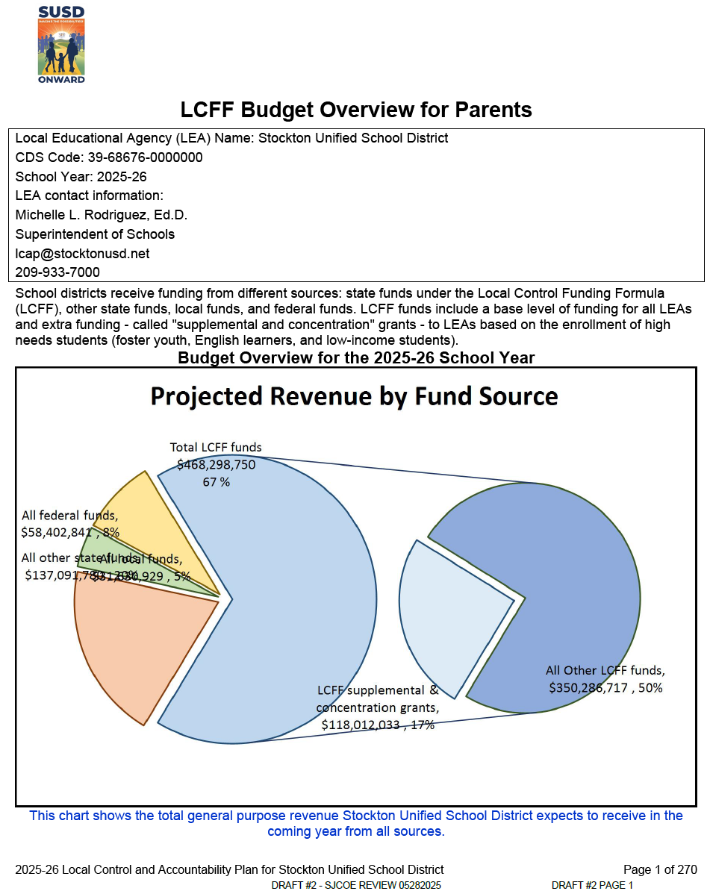
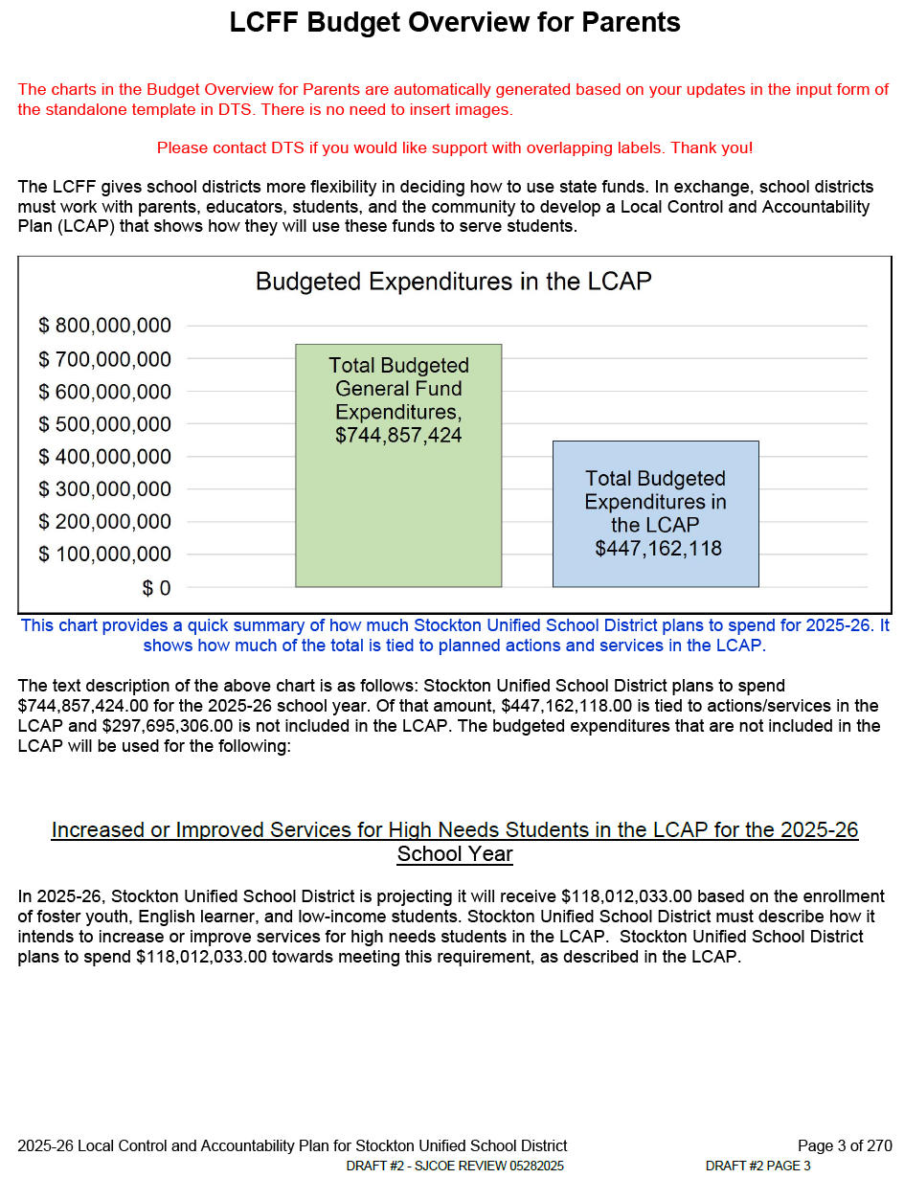
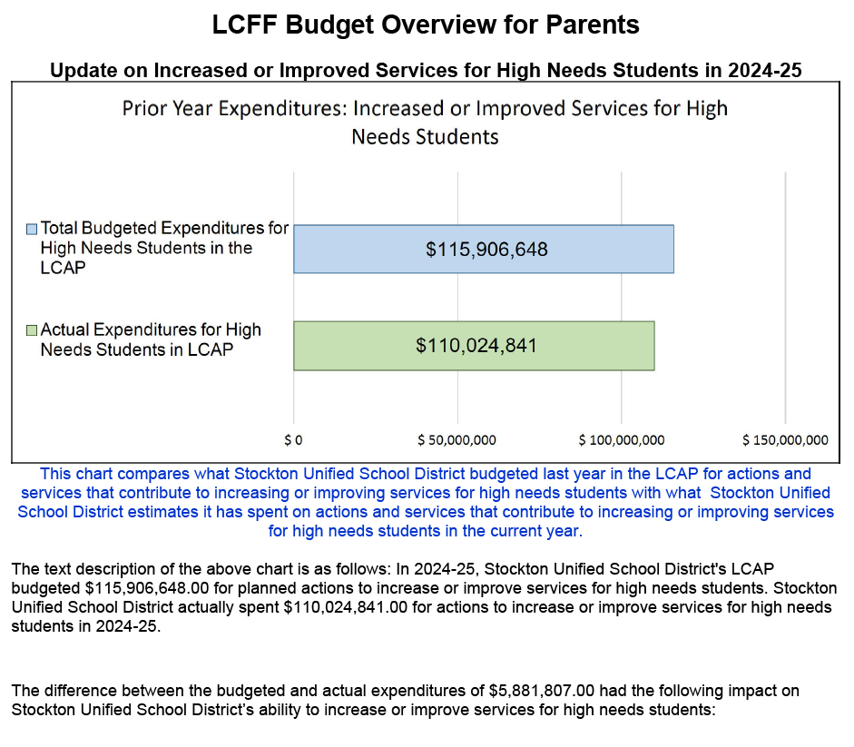
Budget Overview for Parents (BOP)
Purpose:
Summarizes high level financial information
from the Proposed Budget and LCAP
SAMPLE IMAGES – REFER TO THE BOARD AGENDA FOR FINAL DOCUMENTS
Notes:
The first section of the LCAP is the Budget Overview for Parents. This short summary provides a high level overview of the financial information within the LCAP. The Budget Overview for Parents is located on pages 1-3.

Slide 8
Plan summary
General Information
Description of SUSD with demographic data.
Reflections: Annual Performance
Successes (Based on 2023-24 CA School Dashboard):
~ Chronic Absenteeism – Declined
~ Graduation Rates – Increased
~ Suspension Rates – Decreased
~ Academic Performance – Mathematics – Improved
~ Academic Performance – ELA – Maintained
Challenges (Based on 2023-24 CA School Dashboard):
~ English Learner Progress Indicator – Declined*
Reflections: Technical Assistance
Eligible for Differentiated Assistance (DA)
~ Long-Term English Learners (LTEL) for Priority 4
(Academic Performance) for ELA and Math, Priority 6
(Climate) for Suspension, and Priority 8 (Broad Course
Outcome) for the Career and College Indicator
~ Foster Youth (FY) for Priority 4 (Academic Performance)
for ELA and Math, Priority 6 (Climate) for Suspension
Eligible for Differentiated Technical Assistance (DTA)
~ American Indian/Alaska Native, Foster Youth, Homeless,
Students with Disabilities
* Preliminary 2024-25 ELPI and Reclassification is showing positive results.
Bonus LCAP Content References
Learning Recovery Emergency Block Grant (LREBG) - NEW
Notes:
The second section of the LCAP is the Plan Summary, located on pages 4-14. This plan summary includes two prompts: Annual Performance Summary and Technical Assistance.
The Annual Performance Summary identifies the district’s success, where the district has shown growth/improvement in as reported from the 2024 California School Dashboard, additional Dashboard reports, the establishment of programs, and local indicators. There were areas that reported challenges as reported from the 2024 California School Dashboard, additional Dashboard reports and activities. I would like to note that preliminary data for the English Learner Progress Indicator is showing positive results.
The Technical Assistance prompt gives information on the Differentiated Assistance (DA) and Differentiated Technical Assistance (DTA) that the district has met eligibility criteria for. The information includes the student groups eligible and the associated indicator, then a summary of the work underway. The work is being lead by Educational Services.

Slide 9
Educational partners
THANK YOU!!!
Our Journey in Review
September 13 & 17, 2024 - LCAP Kick Off and Update
September 17, 2024 – LCAP Kick Off and Update
October 24, 2024 – Data Analysis Protocol Overview
November 5, 2024 – Data Review/Discussion – Goal 1 & 5
November 20, 2024 – Superintendent’s Student Advisory
January 7, 2025 – Data Review/Discussion – Goal 2 & 3
January 13, 2025 – Data Review/Discussion – Goal 1 & 6
February 25, 2025 – Mid-Year Update
April 28, 2025 – LCAP Study Session
LCAP Connections
Parent Advisory Meetings
Bargaining Unit groups
LCAP Team Meetings
Department and District Events
Notes:
The third section of the LCAP is an overview of educational partner engagement referenced in pages 15-24. Over the course of the year, the LCAP Team has connected with educational partners opening dialogue for feedback and insights during the LCAP Engagement Sessions and numerous meetings with educational partners.

Slide 10
LCAP Goals
Goal 2
Centering Around the Whole Child, Whole Family, Whole Community
Goal 1 – 6: LCFF Base and LCFF S&C funded
~ Goal 2 (Short Title): Added “Whole Family, Whole Community”
Goal 7 & 8: Equity Multiplier funded – Identified School Sites Only
~ 2025-2026 = 9 schools (Adams, El Dorado, Hazelton, Roosevelt, Van Buren, Wilson, Jane Frederick, Stagg, Stockton High)
LREBG: Incorporated into actions within goals 1, 2, and 4
Notes:
The fourth section of the LCAP is the heart of the plan – it is the Goals and Actions, which referenced through pages 25 - 176. The LCAP’s goals associated with LCFF Base and Supplemental & Concentration funds are 1 through 6.
Effective last year, Equity Multiplier funding goals were added to the LCAP for school sites identified as meeting the criteria for the funding. Annually, school sites are reviewed and identified as meeting Equity Multiplier criteria. Although a school may be identified in a new year, the identification is specifically for that specific school year. This year we have 9 school sites identified, with 3 new schools meeting criteria, 6 schools continuing to meet criteria. We have had one school demonstrate improvement; therefore, they did not meet criteria and are not longer identified as an Equity Multiplier funded school.
This year, Learning Recovery Emergency Block Grant funds are required to be included in with the LCAP. These funds supports actions in goal 1, 2, and 4.
From our educational partner feedback, we have expanded the short title for goal 2, adding Whole Family, Whole Community to ready in its entirety “Centering Around the Whole Child, Whole Family, Whole Community.

Slide 11
LCAP Actions and elements
Action Summary
Goal 1 = 16 actions
Goal 2 = 24 actions
Goal 3 = 4 actions
Goal 4 = 4 actions
Goal 5 = 8 actions
Goal 6 = 7 actions
Goal 7 = 6 actions
Goal 8 = 3 actions
Goal Analysis
Prompt 1 = Implementation
Prompt 2 = Material Difference
Prompt 3 = Effectiveness
Prompt 4 = Changes
Notes:
Brief summary:
Within each goal, there is a goal analysis component that consists of 4 questions/prompts: they are: Prompt 1 = Implementation, Prompt 2 = Material Difference, Prompt 3 = Effectiveness, Prompt 4 = Changes
Each goal has actions that are provide an overview/framework of the intended work to be completed during the LCAP plan period.

Slide 12
Increased or improved services
Purpose: These actions are directed (focused) on low-income, English Learner, and Foster Youth to yield effectiveness in closing opportunity gaps and accelerating academic achievement.
42 Key Actions and Services
Instructional Support & Intervention
English Learner (EL) Support
College & Career Readiness
Social-Emotional & Behavioral Supports
Family & Community Engagement
Extended Learning Opportunities
Criterion
Contributing actions only (S&C funded only)
~ Goal 1 – 13 out of 16
~ Goal 2 – 21 out of 24
~ Goal 3 – 4 out of 4
~ Goal 4 – 4 out of 4
Unduplicated Pupils (low-income, English Learner, Foster Youth)
Clearly identifies the need
Need is based on at least 1 CA School Dashboard metric
Implementation is specific
15% Additional Concentration
Goal 2 – 4 actions (11, 13, 15, and 18)
Notes:
For actions that are funding using LCFF S&C, it is required the district demonstrations the work being implemented increase or improved access or services to students who are low-income, English Learner, and Foster Youth. This sections has been refined as of last year to better articulate the throughline based on the identified need and a more robust narrative description of how the district intends to increase or improve student outcomes. This is an important section because if we are unable to demonstrate increased or improved services (using identified metrics) then the action/framework must be changed, which would be reflective in the next 3-year LCAP plan.

Slide 13
LCAP Summary tables
Purpose: These tables provide the educational partner with and “at-a-glance” view of the fiscal landscape of the LCAP.
2025-26 Total Expenditures Table
Summary of all proposed expenditures for all actions identified in the LCAP.
~ For the purposes of this table expenditures and
allocation are the same.
2024-25 Contributing Actions Annual Update Table
Summary of all S&C funded actions identified in the LCAP in the prior LCAP.
2025-26 Contributing Actions Table
Summary of all S&C funded actions identified in the LCAP.
2024-25 LCFF Carryover Table
Summary of unspent S&C funds from the prior LCAP.
2024-25 Annual Update Table
Summary comparison of all action identified in the prior year LCAP.
Notes:
The LCAP Summary tables are an “at-a-glance” view of the fiscal landscape of the LCAP – upcoming year and current (prior year).

Slide 14
LCAP CHANGES
Notes:
Prompt 4 of the goal analysis requires for documentation of changes to each goals components. I will briefly summarize the changes for each goal.

Slide 15
GOAL #1 – action changes
Student Academic Achievement
Changes to Actions:
Action 1.1 – Revised action description to reflect current action implementation. Moved Career Exploration Software and Programs to Action 1.2. Removed statement, "These activities are intended..."
Action 1.2 – Added "Career Exploration Software and Programs" narrative to the action description.
Actions 1.4, 1.6, 1.7, 1.12, and 1.13 – Added Learning Recovery Emergency Block Grant (LREBG) requirements which includes proposed use of funds, projected allocation for 2025-2026 and 2026-2027 school years, research in support of the strategy, and identified metrics.
Action 1.6 – Removed duplicative narrative regarding translation services.
Action 1.13 – Revised action description to provide improved clarity for parents.
Action 1.16 – Revised action description to provide improved clarity for parents.
Notes:
Changes within goal 1 include:
Moving an action component, Career Exploration Software and Programs, from action 1.1 to 1.2.
Added Learning Recovery Emergency Block Grant references to actions 1.4, 1.6, 1.7, 1.12, and 1.13
Revised the action description for improved clarity.

Slide 16
GOAL #2 – action changes
Centering Around the Whole Child,
Whole Family, Whole Community
Changes to Actions:
Action 2.5 – Added “Coordinator” to clarify the position title as “PBIS Coordinator”.
Action 2.11 - Narrative was updated to improve clarity for parents including the inclusion of "Saturday School" activities
Action 2.13 – Corrected typographical error to position title to read “Psychologists”.
Action 2.14 – Added Learning Recovery Emergency Block Grant (LREBG) proposed use of funds and projected allocation for 2025-2026 and 2026-2027 school years.
Notes:
Changes within goal 2 include:
Goal short title now reads: Centering Around the Whole Child, Whole Family, Whole Community
Added inclusion of Saturday school to action 2.11
Added Learning Recovery Emergency Block Grant references to action 2.14
Revised the action description for improved clarity.

Slide 17
GOAL #2 – action changes (cont’d)
Centering Around the Whole Child,
Whole Family, Whole Community
Changes to Actions:
Action 2.16 – Revised Action Title Field to read: Sustainability of Assistant Principals According to School-Specific Needs and Staffing Ratio Guidelines. In the Action Description/Narrative field, added a clarifying phrase “using a ratio to determine site needs” to describe how positions are determined at school sites. Removed the limitation of "Tk-8" grades to expand support to high schools as well.
Action 2.19 - Revised second paragraph in the action description to correct the position title to "Network Support Technicians".
Action 2.20 - Narrative was updated to provide clarity for parents and update from student "laptops" to “Chromebooks".
Action 2.22 – Added Learning Recovery Emergency Block Grant (LREBG) proposed use of funds and projected allocation for 2025-2026 and 2026-2027 school years.
Notes:
Changes within goal 2 include:
Revised action title for action 2.16
Added Learning Recovery Emergency Block Grant references to action 2.22
Revised the action description for improved clarity.

Slide 18
GOAL #3 – action changes
Passions, Interests and Talents
of the Modern Student
Changes to Actions:
Action 3.1 - Added clarifying specific student activity clubs and job-skill based experiences. Added State Seal of Civic Engagement (SSCE) as a student engagement and leadership opportunity.
Action 3.3 - Revised narrative description to better reflect Arts programming and opportunities being implemented.
Notes:
Changes within goal 3 include:
Added specific student activities, clubs, job-skill based experiences to action 3.1
Revised action 3.3 to reflect current implementation of Arts programming and opportunities

Slide 19
GOAL #4 – action changes
Meaningful Partnerships
Changes to Actions:
Action 4.1 – Added Learning Recovery Emergency Block Grant (LREBG) proposed use of funds and projected allocation for 2025-2026 and 2026-2027 school years.
Action 4.4 – Added clarity of parent advisory committees/groups.
Notes:
Changes within goal 4 include:
Added Learning Recovery Emergency Block Grant references to action 4.1
Revised the action description for improved clarity.

Slide 20
GOAL #5 – action changes
Success for Students with Disabilities
Changes to Actions:
Actions 5.1, 5.3, 5.4, 5.6, 5.8 – Revised action description to reflect current action implementation and to provide improved clarity for parents.
Action 5.2 – Replaced Action Title field with correct action title “Maximize Course Access & Alternate Diploma Pathways”.
Action 5.3 – Replaced Action Title field from "Accelerate Learning for all SPED Red students" with "Academic Supports to Accelerate Learning".
Notes:
Changes within goal 5 include:
Replaced action titles for action 5.2 and 5.3
Revised the action description for improved clarity.

Slide 21
GOAL #6 – action changes
African American/Black Students Thrive
Changes to Actions:
Action 6.1 – Renamed Action Title field to read “Student Achievement Master Plan”. Revised and updated Action Description narrative to correlate with district activities, procedures, and practices.
Action 6.2 – Renamed Action Title field to read “Data Driven Alignment with School Plan for Student Achievement (SPSA)”. Revised and updated Action Description narrative to correlate with district activities, procedures, and practices.
Action 6.3 – Renamed Action Title field to read “Educator Gap Balancing and Recruitment Process”. Revised and updated Action Description narrative to correlate with district activities, procedures, and practices.
Action 6.4 – Renamed Action Title field to read “K-8 Academic Supports: Culturally Responsive Text Set Development, Individual Student Needs Assessment and Curriculum & Pedagogy”. Revised and updated Action Description narrative to correlate with district activities, procedures, and practices.
Notes:
Changes within goal 6 include:
Revised action title for actions 6.1, 6.2, 6.3, 6.4, 2.16
Revised and updated action description narrative to correlate/align with district activities, procedures, and practices; thereby providing improved clarity.

Slide 22
GOAL #6 – action changes (cont’d)
African American/Black Students Thrive
Changes to Actions:
Action 6.5 – Renamed Action Title field to read “Community Partnerships”. Revised and updated Action Description narrative to correlate with district activities, procedures, and practices. Merged action 6.8 as it directly aligns with connecting community partnership services, supports, and resources to school sites.
Action 6.6 – Renamed Action Title field to read “Development of High School African American Studies Course”. Revised and updated Action Description narrative to correlate with district activities, procedures, and practices.
Action 6.7 – Renamed Action Title field to read “School Climate & Wellness Personnel Support”. Revised and updated Action Description narrative to correlate with district activities, procedures, and practices.
Action 6.8 – Merged action with 6.5.
Notes:
Changes within goal 6 include:
Revised action title for actions 6.5, 6.6, 6.7
Merged action 6.8 with action 6.5.

Slide 23
GOAL #7 – action changes
Success of the Modern K-8 Student
Changes to Actions:
Actions 7.1, 7.2, 7.3, and 7.4 have been removed associated with prior year’s Equity Multiplier schools.
Actions were added based on the current elementary schools identified in February 2025. New actions reflect the framework for implementation unique for each Equity Multiplier site.
Action 7.1 – Adams Elementary
Action 7.2 – El Dorado Elementary
Action 7.3 – Hazelton Elementary
Action 7.4 – Van Buren Elementary
Action 7.5 – Roosevelt Elementary
Action 7.6 – Wilson Elementary
Notes:
Changes within goal 7 include:
Removed actions 7.1, 7.2, 7.3, and 7.4 as they were associated with prior year’s Equity Multiplier schools.
Added actions 7.1, 7.2, 7.3, 7.4, 7.5, and 7.6 to reflect the framework for implementation unique for each Equity Multiplier site.
Equity Multiplier Schools are:
Action 7.1 – Adams Elementary
Action 7.2 – El Dorado Elementary
Action 7.3 – Hazelton Elementary
Action 7.4 – Van Buren Elementary
Action 7.5 – Roosevelt Elementary
Action 7.6 – Wilson Elementary

Slide 24
GOAL #8 – action changes
Graduating College, Career and Life Ready at Equity Multiplier High Schools
Changes to Actions:
Actions 8.1, 8.2, and 8.3 have been removed associated with prior year’s Equity Multiplier schools.
Actions were added based on the current high schools identified in February 2025. New actions reflect the process that schools will take to develop and implement the Equity Multiplier actions.
Action 8.1 – Stockton High School
Action 8.2 – Jane Frederick
Action 8.3 – Stagg High School
Notes:
Changes within goal 8 include:
Removed actions 8.1, 8.2, and 8.3 as they were associated with prior year’s Equity Multiplier schools.
Added actions 8.1, 8.2, and 8.3 to reflect the framework for implementation unique for each Equity Multiplier site.
Equity Multiplier Schools are:
Action 8.1 – Stockton High School
Action 8.2 – Jane Frederick
Action 8.3 – Stagg High School
I would like to take a moment to take our educational partners for their engagement and feedback, staff for their insight on actions, and Cabinet for their leadership. A special acknowledgement to my Administrator, Ashlee Frades, for her support and help navigating the changes the LCAP realm.

Slide 25
Share your voice

Slide 26
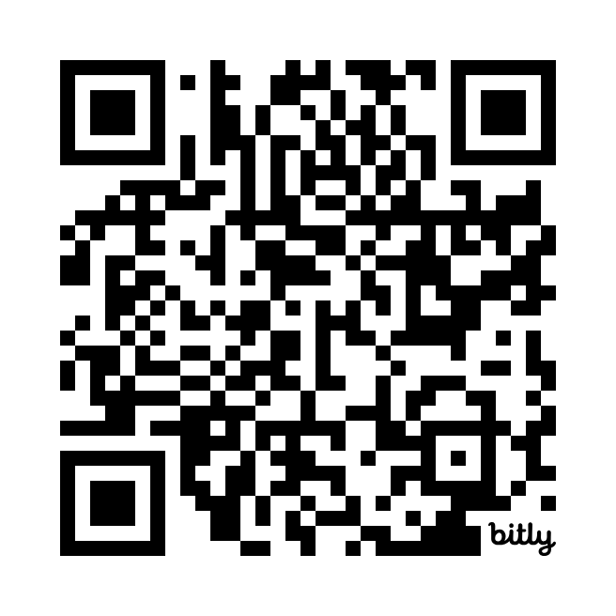
Share your voice
2024-2027 LCAP Survey - YOUR VOICE MATTERS!
HIGHLIGHTS
One survey for ALL years of the LCAP
Natural language model
Unlimited Survey Responses
Available in 6 languages!
Real-time updates LCAP webpage
Notes:
Please continue to share your voice – experiences, thoughts, feedback changes over the course of a year and we look forward to capturing your voice.

Slide 27
THANK YOU!

